Slide 1
Automatic Number Plate Recognition System Using Python
DONE BY : AISHWARYA.N
Department OF : INFORMATION TECHNOLOGY
ST. JOSEPH’S COLLEGE OF ENGINEERING

Slide 2
Abstract
The main objective of the project is to monitor the vehicles that are entering and going out of the organization. All the vehicle must have their own unique license plate number, so the extraction of vehicles number plate plays a major role in this system. The vehicle number plate is captured by the camera which is placed in the entrance. The captured image is then processed by Automatic Number Plate Recognition (ANPR). This method is efficient way recognizing the vehicle number plate. A database is created with the vehicle number which are belongs to that particular organization. The recognized number plate is then compared with the database and checks whether the vehicle belongs to organization or is it an unknown vehicle. Then the entry and exit time of the organization vehicles are recorded.

Slide 3
Introduction
All the vehicles have a unique vehicle identification number as their main identifier. The identifier is actually the license number that refers to a legal license to participate in the public movement. Each and every vehicle has its own unique number plate. For the identification of vehicle the number plate is common in all aspects.
The attendance of the organization vehicle is being taken by the security in the entrance. So for this our system will provide entry and exit time of the vehicle by automating it rather than doing manually, and also our system includes detection of unknown or outsider vehicles coming into the premises.
To identify the vehicle we use IR sensor or ultrasonic sensor which will be useful in detecting the vehicles coming into the organization. If the vehicle is nearing the sensor then it is triggered and activates the camera to capture the image automatically.

Slide 4
The captured image undergoes image processing to recognize the vehicle number. The recognition of number plate involves steps such as 1) Image acquisition 2) Image preprocessing 3) Plate localization 4) Character segmentation 5) Character recognition. The database is created initially which contains the vehicle number belonging to the organization. Vehicles may belong to undergrads vehicles, staff vehicles, student vehicles their data are collected into the database.
The recognized vehicle number from the result of image processing is been compared with the existing database those number plate which are matched are stored in the database with their corresponding entry and exit and this data are authorized vehicle those number plate which are not matched will be maintained with unauthorized vehicle. This information will enable more security information and also provides with the regularly maintaining of the records.

Slide 5
Existing System
In the existing system number plates appear in different types of character styles, either single or double row, different sizes, spacing and character counts. Due to such kind of variations even localizing or detecting these plates becomes a tedious process. In the existing system, foreground estimation is done by Gaussian mixture model then proposing a real time and robust method of license plate extraction based on block variance technique. License plate extraction is an important stage in license plate recognition for automated transport system. The Extracted license plates are segmented into individual characters by using a region-based approach. The recognition scheme combines adaptive iterative thresholding with a template matching algorithm.

Slide 6
Disadvantages Of Existing System
The existing method cannot work properly on degraded images with a complex background.
Low accuracy.
Noise content was high.
They do not take into consideration of the noise or the image normalization in the input image.
These methods do not show high contrast image for the output image.
Manual assessment is subjective, time consuming and expensive
In these methods, selection of features and classification strategy is difficult and challenging
Poor and Inaccurate segmentation result

Slide 7
Proposed System
This project is on the development of new approaches for extraction of license plates. The proposed algorithm is based on video acquisition, extraction of plate region, segmentation of plate characters and recognition of characters. Extraction of plate is a difficult task. In this project, a simple license plate extraction method is presented. The method is basically based on the Edge Detection algorithm including four major stages, which are RGB to gray-scale conversion, Gaussian Blurring, morphological operations and extracting the accurate location of the license plate. Mean squared error method is used for recognition of characters.
In our framework we intended to screen what are the vehicles entering in to the school/college/office Premises and leaving the premises.We need screen this with both in time and out time and furthermore we need arrange that vehicle which are undergrads vehicles, staff vehicles and others vehicle by utilizing number plate in vehicle. In light of the order of vehicle it need to store in database.

Slide 8
Block Diagram
Raspberry pi3
camera
Power supply
database
Ultrasonic sensor
Servo motor

Slide 9
Working Flow chart
start
E
N
T
R
Y
Vehicle detection
E
X
I
T
Capture image
Capture image
Convert image to text
Convert image to text
If license plate is matched
Store exit time
Store entry time
Unknown vehicle identified
Stop

Slide 10
Module
A power supply of +5v is given to the raspberry pi.
Ultrasonic sensor(HC-SR04) is placed at the entrance and it triggers the camera when a vehicle enters the organisation.
Camera (Logitech C525) is used to capture the vehicle.
Servo motor is used to change the angle of the camera to monitor both entry and exit of the vehicle.
Raspberrypi 3 is used as the central processing unit and is used to process the captured image.
Finally the number plate is extracted and the entry and exit time is stored in the database.

Slide 11
Requirements
HARDWARE | SOFTWARE
1. Raspberry Pi-3. | Anaconda.
2. Power Supply.(+5.1V micro USB supply) | 2. Pycharm.
3. Ultrasonic Sensor. (HC-SR 04) | Open CV
4. Servo motor. (Tower Pro SG90)
5. Camera. (C525 Web cam)

Slide 12
Open CV
OpenCV (Open Source Computer Vision Library) is an open source computer vision and machine learning software library, it was built to provide a common infrastructure for computer vision applications and to accelerate the use of machine perception in the commercial products. OpenCV makes it easy for businesses to utilize and modify the code.
The library has more than 2500 optimized algorithms, which includes a comprehensive set of both classic and state-of-the-art computer vision and machine learning algorithms.
These algorithms can be used to detect and recognize faces, identify objects, classify human actions in videos, track camera movements, track moving objects, extract 3D models of objects, produce 3D point clouds from stereo cameras, stitch images together to produce a high resolution image of an entire scene, find similar images from an image database, remove red eyes from images taken using flash, follow eye movements, recognize scenery and establish markers to overlay it with augmented reality, etc.
It has C++, Python, Java and MATLAB interfaces and supports Windows, Linux, Android and Mac OS. OpenCV leans mostly towards real-time vision applications and takes advantage of MMX and SSE instructions when available. A full-featured CUDA and OpenCL interfaces are being actively developed right now. There are over 500 algorithms and about 10 times as many functions that compose or support those algorithms.

Slide 13
Raspberry Pi
This project makes use of an onboard computer, which is commonly termed as Raspberry Pi2 processor. It acts as heart of the project. This onboard computer can efficiently communicate with the output and input modules which are being used. The Raspberry pi is a credit-card sized single board computer which was firstly developed in UK by the Raspberry pi foundation. Basically, the operating system for the detection of vehicle number plate using Raspberry pi is the Raspbian JC. For the recognition purpose, Raspberry pi model3 is used.
Raspberry pi is a SOC (system on chip) device has inbuilt 1.2 GHz BCM 2837 Arm Cortex processor. The arm cortex processor is 64 bits. Raspberry pi has 1GB Ram. The overall average power is ranging from 1.5 to 6.7 watt. Raspberry pi has 40 digital input output pins in which 27 pins are GPIO (General Purpose Input Output). It has operating system which is installed in external SD card for booting and long term storage.
The recognition of vehicle number plate is working in four steps. The first one is image acquisition, second is license plate extraction, third one is license plate segmentation, and last one is character recognition. OCR is the process which converts image into text.
The Raspberry Pi 3 Model B uses a Broadcom BCM2837 SoC with a 1.2 GHz 64-bit quad-core ARM Cortex-A53 processor, with 512 KB shared L2 cache. All SoCs used in Raspberry Pis are custom-developed under collaboration of Broadcom and Raspberry Pi Foundation.

Slide 14
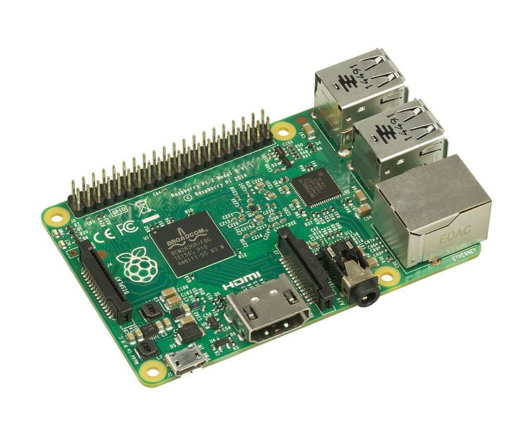
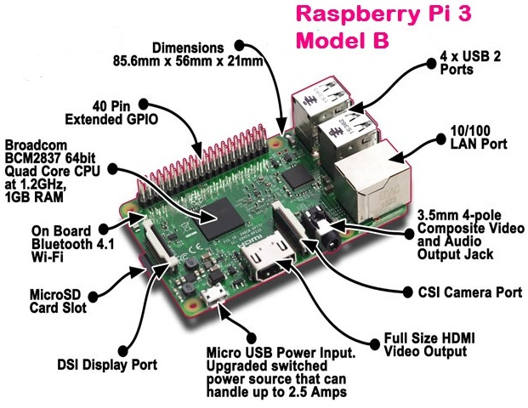
RASPBERRY PIE 3.0

Slide 15
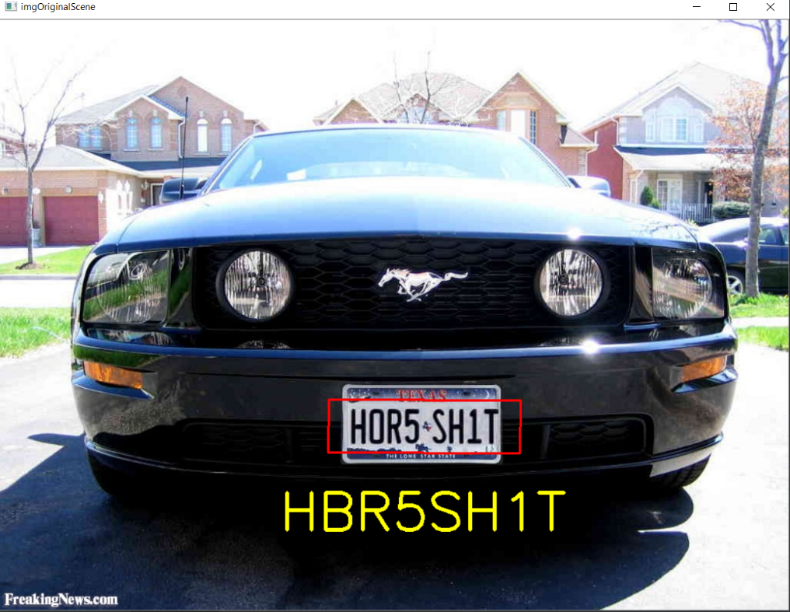
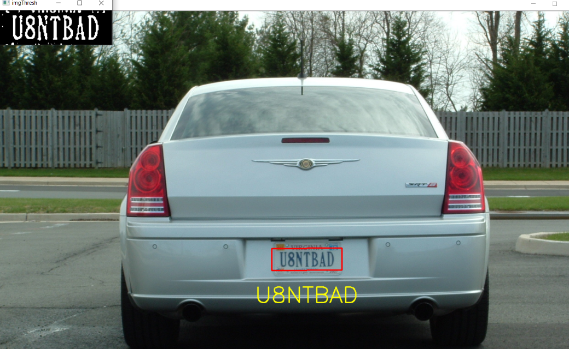
Output image

Slide 16
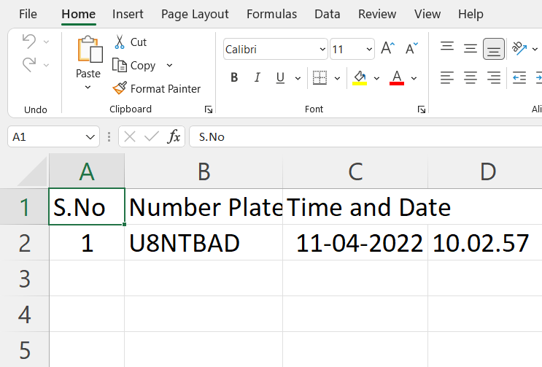
Output

Slide 17
Conclusion
ANPR applications are becoming increasingly complex in Indian context with the phenomenal exponential growth in car, two-wheeler and auto Industries. ANPR applications like automatic toll collection, automatic charging system in parking spaces, management vehicles in parking spaces, and traffic monitoring, etc., have posed new research tasks in ANPR with newer dimensions.
This system can be widely used among the gated communities and other organizations in order to monitor their campus vehicle and to show their exact status of their campus vehicles.

Slide 18
Limitations of the project
Camera should be of good quality. Otherwise, correct text from image would not be extracted properly.
There should be proper lighting.
This system does not respond properly under different illumination conditions.
Although accuracy is high, mean squared error leads to low computational results

Slide 19
Future Scope
The implementation of the proposed system can be extended for the recognition of number plates of multiple vehicles in a single image frame. User friendly android applications can be developed for traffic surveillance management systems. Also, character recognition can be done using various deep learning algorithms as they yield more accuracy. GPUs can be used to achieve more performance in terms of computational time.
If it can be made concise then it can also be fitted in police cruisers and other law enforcement division vehicles to make the world a more safer place

Slide 20
THANK YOU!!

